Slide 1
UNIDAD 2 ACTIVIDAD 1 MOMENTO INDEPENDIENTE
KEINER RIQUET FRAGOSO
DOCENTE LILIANA HERNÁNDEZ
FUNDACIÓN UNIVERSITARIA SAN MATEO
INGENIERIA SST
BOGOTA D.C
22-03-2019

Slide 2
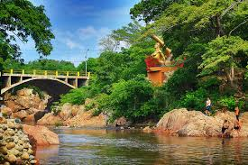
2019
APRIL
THE RIVER HURTADO
Sunday | Monday | Tuesday | Wednesday | Thursday | Friday | Saturday
 |  |  |  |  | 1 One | 2 Two
3 three | 4 Four | 5 Five | 6 Six | 7 Seven | 8 Eigth | 9 Nine
10 ten | 11 Eleven | 12 Twelve | 13 Thirteen | 14 Fourteen | 15 Fiveteen | 16 Sixteen
17 seventeen | 18 Eigthteen | 19 Nineteen | 20 Twenty | 21 Twenty One | 22 Twenty Two | 23 Twenty Three
24 twenty four | 25 Twenty Five | 26 Twenty Six | 27 Twenty Seven | 28 Twenty Eigth | 29 Twenty Nine | 30 Thirty
31 thirty-one
FESTIVAL DE LA LEYENDA VALLENATA FIESTA CULTURAL QUE SE CELEBRA DEL 26 AL 30 DE ABRIL.
FESTIVAL OF THE VALLENATA LEGEND CULTURAL PARTY THAT IS CELEBRATED FROM 26 TO 30 APRIL.

Slide 3
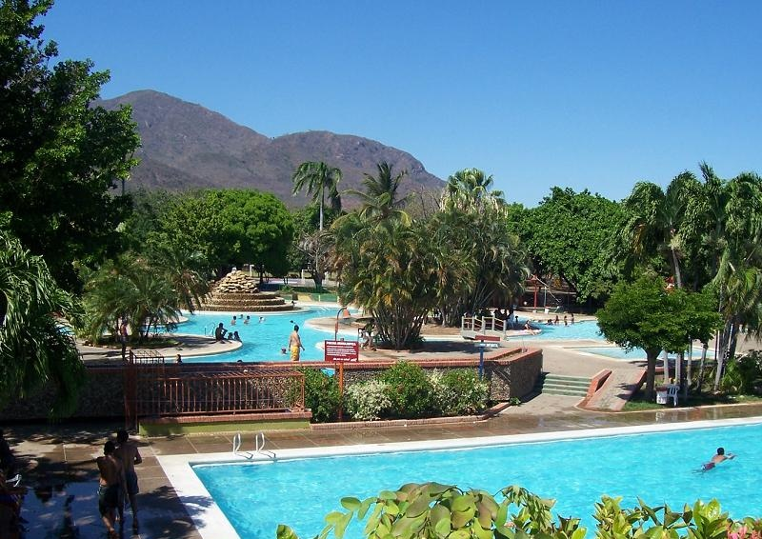
2019
August
THE RECREATIONAL CENTER LA PEDREGOSA
Sunday | Monday | Tuesday | Wednesday | Thursday | Friday | Saturday
 |  |  |  |  | 1 One | 2 Two
3 three | 4 Four | 5 Five | 6 Six | 7 Seven | 8 Eigth | 9 Nine
10 ten | 11 Eleven | 12 Twelve | 13 Thirteen | 14 Fourteen | 15 Fiveteen | 16 Sixteen
17 seventeen | 18 Eigthteen | 19 Nineteen | 20 Twenty | 21 Twenty One | 22 Twenty Two | 23 Twenty Three
24 twenty four | 25 Twenty Five | 26 Twenty Six | 27 Twenty Seven | 28 Twenty Eigth | 29 Twenty Nine | 30 Thirty
31 thirty-one
FERIA GANADERA CERTAMEN AGROPECUARIO QUE SE REALIZA DEL 17 AL 20 DE AGOSTO.
LIVESTOCK FAIR IS THE AGROPECUARIO CONTEST THAT IS CARRIED OUT FROM 17 TO 20 AUGUST.

Slide 4
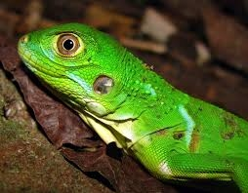
Animal típico de la región Typical animal of the region
La iguana The iguana
es un gran lagarto arbóreo de América Central y de Sudamérica. Miden hasta 2 m de longitud de cabeza hasta la cola y pueden llegar a pesar más de 15 kg, Por lo general, las iguanas suelen vivir de media entre 10 y 20 años, aunque se han registrado casos de iguanas que han superado los 20 años de vida.
It is a large arboreal lizard from Central America and South America. They measure up to 2 m in length from head to tail and can weigh more than 15 kg. In general, iguanas usually live on average between 10 and 20 years, although there have been cases of iguanas that have exceeded 20 years of life.

Slide 5
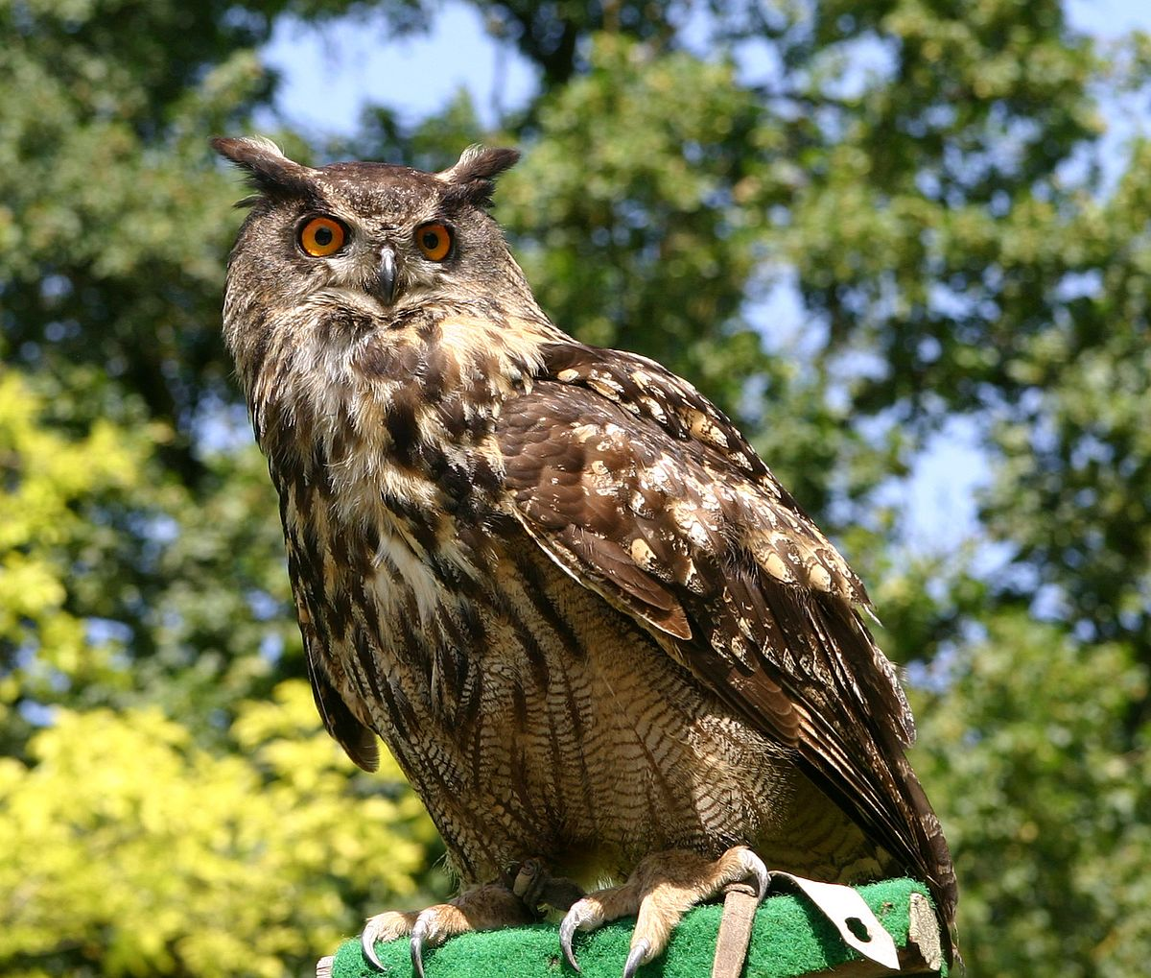
MI ANIMAL FAVORITO MY FAVORITE ANIMAL
Mi nombre es Keiner Riquet, mi animal favorito es el búho porque son muy inteligentes y de vida nocturna, tienen una visión excepcional que le permite ser buenos cazadores, se alimentan de roedores, insectos, peces, son muy amigables y me gustan las tonalidades en sus ojos, plumas y movimiento de su cabeza, el mas pequeño de la especie es el búho pigmeo y el único lugar donde no existen es en la Antártida.
Audio
https://www.dropbox.com/home/English?preview=WhatsApp+Audio+2019-03-22+at+10.23.35+PM.mp4
My name is keiner riquet, my favorite animal is the owl because they are very intelligent and nocturnal, they have an exceptional vision that allows them to be good hunters, they feed on rodents, insects, fish, they are very friendly and I like the tonalities in his eyes, feathers and movement of his head, the smallest of the species is the pygmy owl and the only place where they do not exist is in the antartida.
Audio
https://www.dropbox.com/home/English?preview=WhatsApp+Audio+2019-03-22+at+10.23.35+PM+(1).mp4

